Slide 1
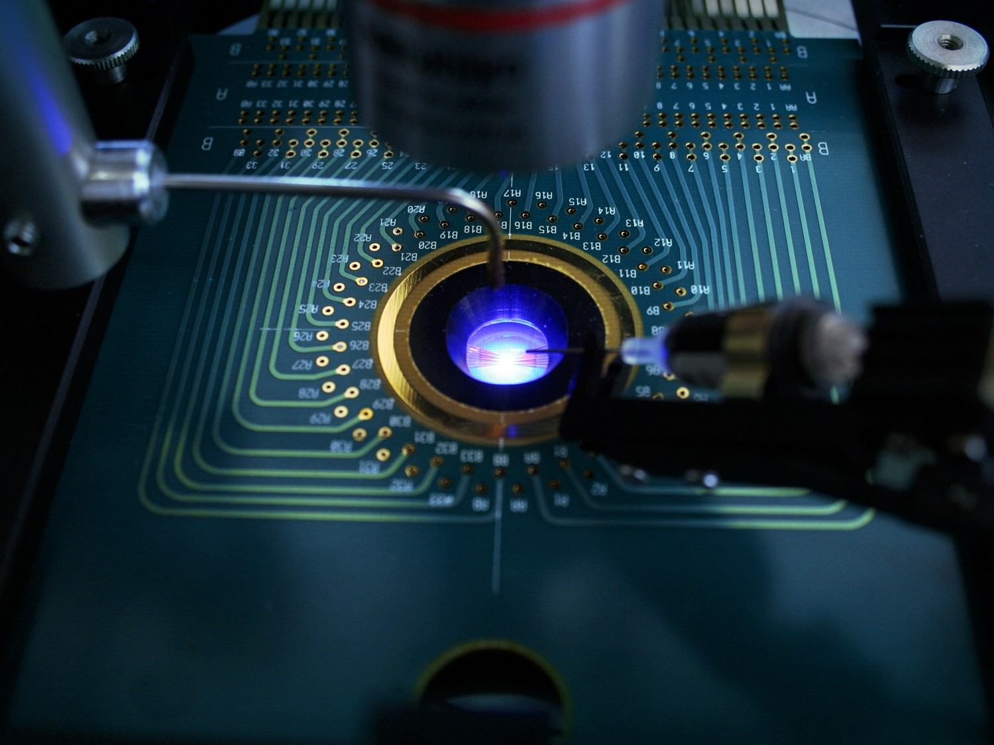
XY Calibration LED Chart

Slide 2
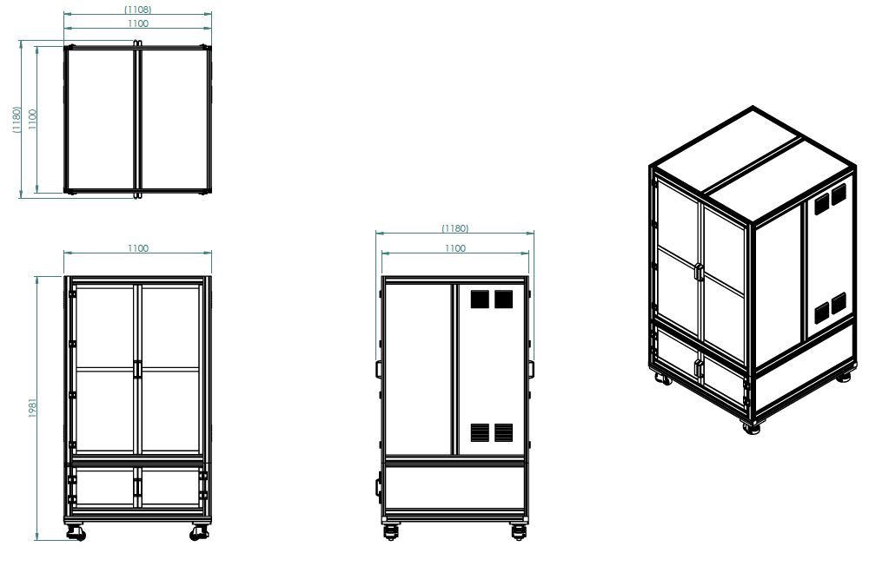
▣ System Overview(XY Cal)
System Dimension [W x D x H] : 1,100x 1,100 x 1981 mm
The current design may differ from the actual product.

Slide 3
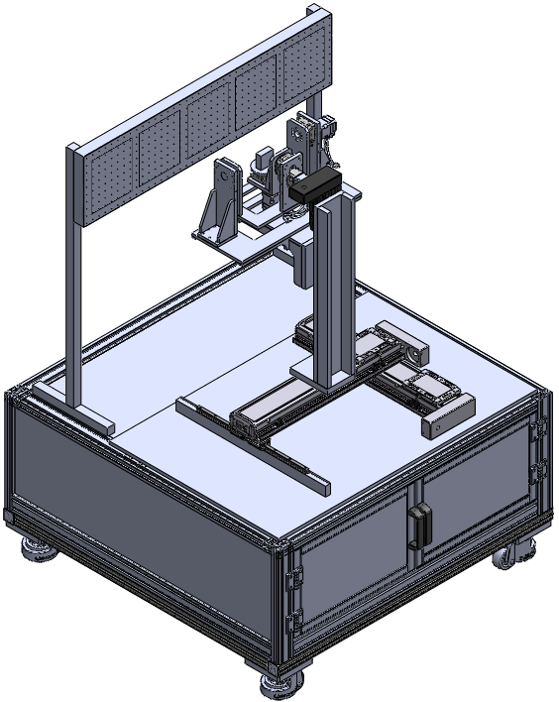
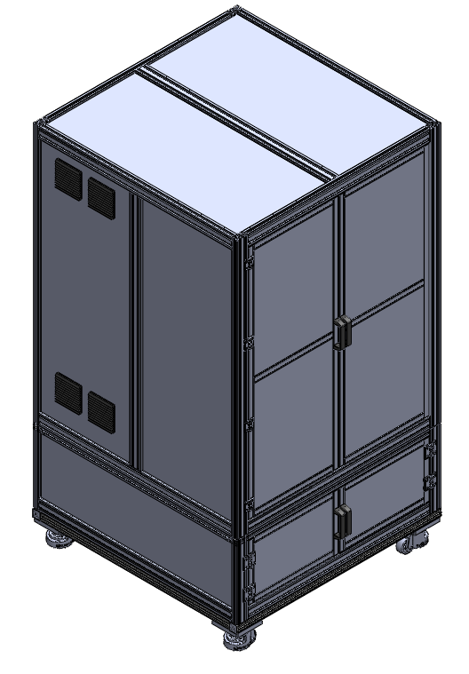
▣ System Overview(Frame, Unit)
Stage
전면 DOOR
배기 FAN
좌우 동일
LED Chart
급기 FAN
좌우 동일
하부 DOOR
The current design may differ from the actual product.

Slide 4
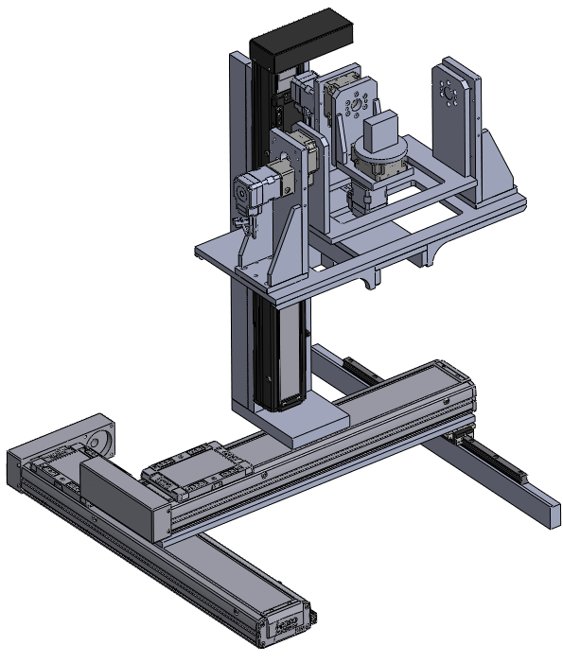
▣ System Overview(Stage)
Ty축.
θ: ±20°
Tx축.
θ: ±20°
R축.
θ: ±30°
# X-Y-Z Spec.
X축 : ±200mm 0.1mm Step
Y축 : ±200mm 0.1mm Step
Z축 : ±200mm 0.1mm Step
# Tx-Ty-θ Spec.
Tx축 : θ: ±20° 0.01 ° Step
Ty축 : θ: ±20° 0.01 ° Step
θ 축 : θ: ±30° 0.01 ° Step
Z축.
ST : ±200mm
X축.
ST : ±200mm
Y축.
ST : ±200mm
The current design may differ from the actual product.

Slide 5
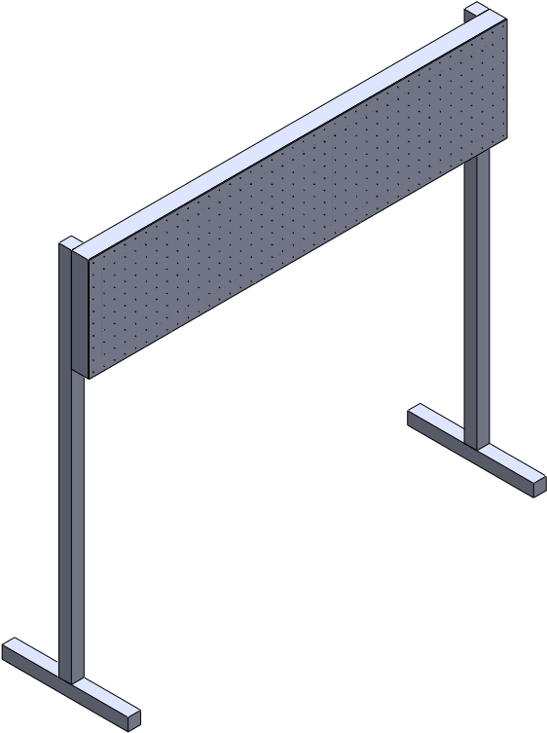
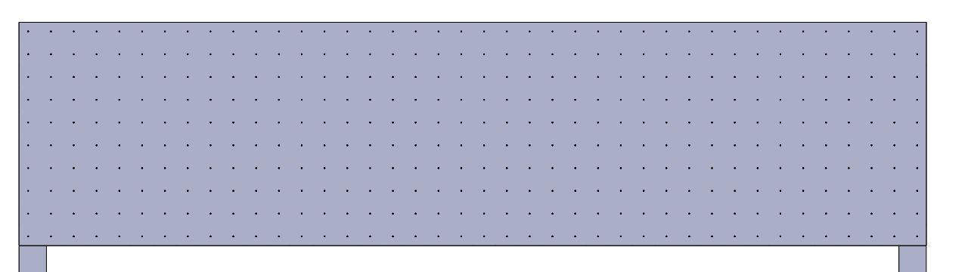
▣ System Overview(Chart)
995
LED MCPCB
LED MCPCB
40X10=400EA 적용.
25mm 간격 배열.
245
The current design may differ from the actual product.

Slide 6
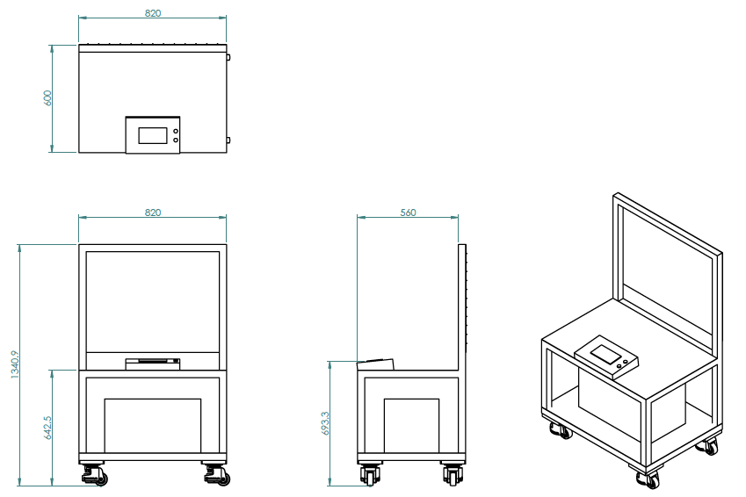
▣ System Overview(이동형 Chart)
System Dimension [W x D x H] : 820x 600 x 1340.9 mm
The current design may differ from the actual product.

Slide 7
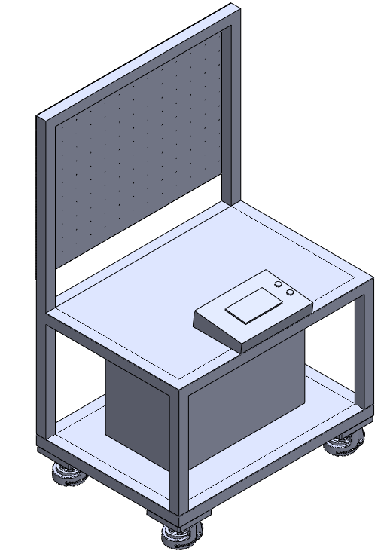
▣ System Overview(이동형 Chart Frame)
발광 방향.
LED MCPCB
이동식 LED 스위치 박스.
이동형 바퀴 및 스톱퍼
일체형.
전장 및 LED 컨트롤박스.
The current design may differ from the actual product.

Slide 8
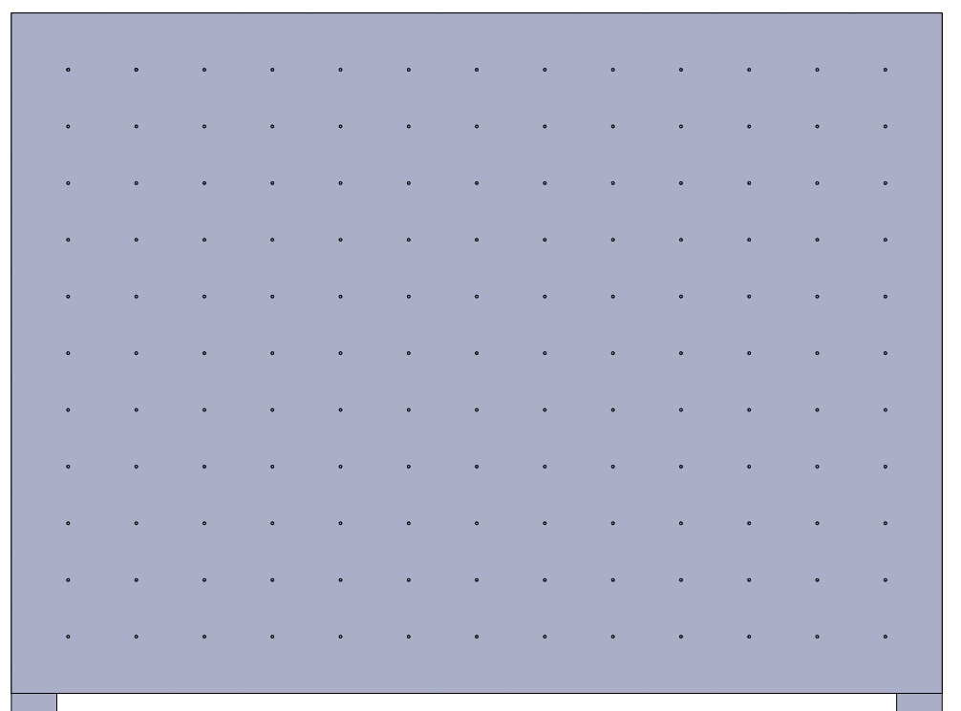
▣ System Overview(이동형 Chart)
820
LED MCPCB
13X11=143EA 적용.
50mm 간격 배열.
600
The current design may differ from the actual product.

Slide 9
▣ System Overview(이동형 Chart, XY LED Chart)
현재의 컨셉은 LED배열 발광 (25mm, 50mm, 100mm)을 기준으로 제작되었습니다. 개별 발광 컨셉으로 제작될 경우, 컨셉이 변경될 수 있습니다.
The current design may differ from the actual product.

Slide 10
THANK YOU
for your attention!

